Slide 1
Individual
Project
By Karima Chheal

Slide 2
Contents:
Intro
Risks
CI Pipeline
Trello - User stories, to do lists
ERD
Demo
Outcomes and improvements
What did I learn?
Conclusion

Slide 3
Intro
Colour palette maker!
Bringing some creativity
One of my favourite things

Slide 4
Risks
Not having a functioning app
Time limits
Over ambitiousness
Lack of proper comprehension - doing it wrong
Issues with software and tools

Slide 5
CI pipeline
Source Code
Version Control
System - Git
Project Management - Trello
CI Server / Jenkins

Slide 6
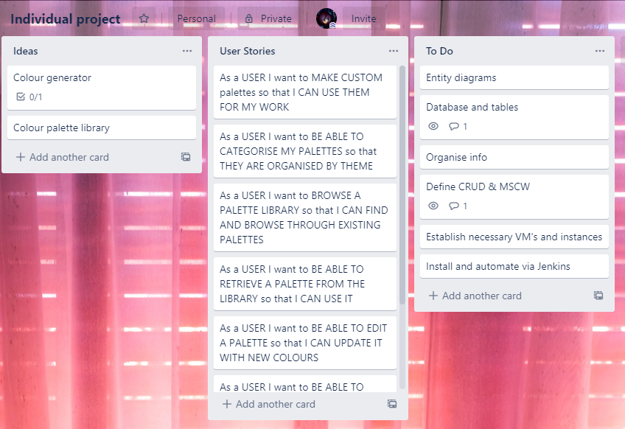
Trello

Slide 7
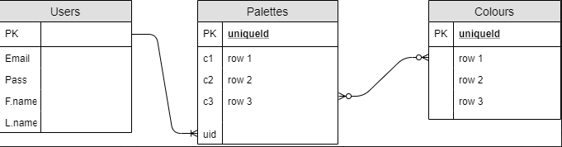
ERD
A user can have many palettes but a palette can only be created by one user - 1 to many
Many palettes can have many colours - many to many

Slide 8
Demo time!

Slide 9
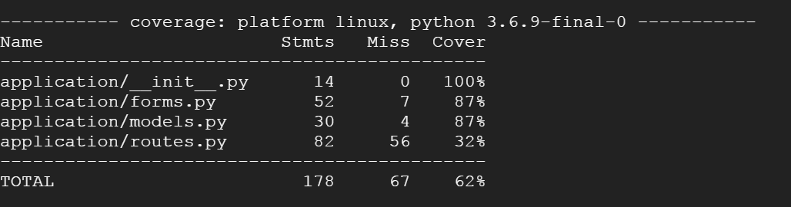
Testing report..

Slide 10
Outcomes, struggles and future improvements
Not a wholly functioning app
Basic
Confusion with some aspects
Organisation and time management
Self confidence
Time constraints
Plan better - organise and time limits
Make sure to be more familiar with tools
Focus on basic CRUD functionality
Experience
Have a clear understanding
Have more confidence!

Slide 11
What did I learn?
Useful shortcuts and tricks to make it easier!
How to follow through iteratively to work through issues, both when coding and the project as a whole
Gained experience - tools, software, managing a project
My own learning style
Even if it’s a solo project, there is an opportunity to learn from those around you

Slide 12
To conclude….
App
Overall thoughts
Can improve

Slide 13
Thank you for listening!

